Slide 1
Measures of Academic Progress
Using MAP Data to Inform Instruction
TIPS Presentation
Santa Ana Unified School District
February 4, 2016

Slide 2
MAP Resources – One Stop Shop Staff > Educational Services > Research & Evaluation > MAP - Measures of Academic Progress
You must log on to the SAUSD staff portal to access these resources; they are not for public access.
Notes:
This screenshot of our district’s MAP webpage was taken on 1/17/2015. The Research and Evaluation department is constantly updating this webpage so please visit it often for the latest files.
The direct link is: http://www.sausd.us/Page/27291
You must log on to the SAUSD staff portal to access these resources; they are not for public access.

Slide 3
What does this tell us about how these two students are doing?
Source: NWEA
Notes:
In the past, much of accountability was based on whether students were “proficient” or “not proficient” on summative tests (for example, the California Standards Tests (CSTs). This type of model doesn’t take into account the starting point for each student nor the progress that students are making.

Slide 4
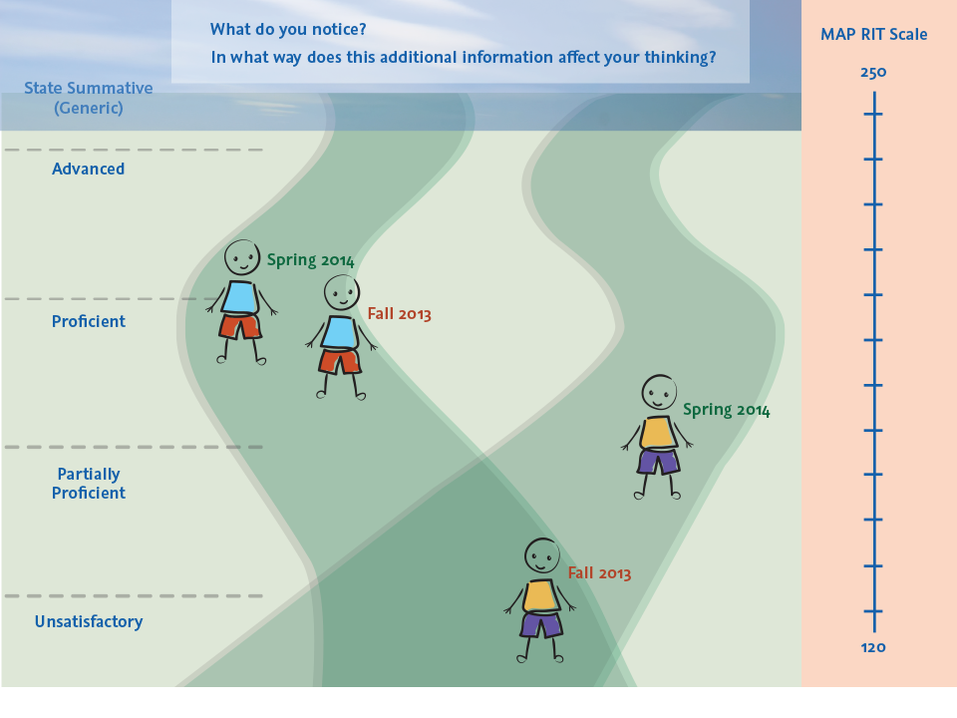
Now, what does this tell us about how these two students are doing? How does this additional information affect your thinking?
A paradigm shift from a status to a growth model
Source: NWEA
Notes:
It is very possible that students who may not be considered “proficient” are actually making considerable growth during the year . . . And even more growth than some students who are considered “proficient.” We may see individual students in 4th grade who are reading at the first grade level at the beginning of the year yet end like a third grader. This student would not be considered “proficient” by a status model, yet this student has made remarkable growth.
MAP is a growth measure that provides information about student progress and growth over time.
MAP is also an assessment that will support our implementation of SBAC (Smarter Balanced Assessment Consortium).
A great source for additional information:
https://www.nwea.org/resources/case-growth-measure-student-learning/

Slide 5
Today, we will. . .
Review MAP key concepts and vocabulary
Explore the Teacher/Class Report and the Class Breakdown Report
Discuss a way to use the Learning Continuum to optimize learning
Take a look at Goal Setting
Share resources that can be used to differentiate instruction

Slide 6
MAP Key concepts and vocabulary . . .
Notes:
The following section will assist teachers in understanding the two key reports presented during this workshop (Teacher/Class Report and Class Breakdown by Goal Report).
You may want to refer to the resource below for assistance with key concepts and vocabulary specific.
www.nwea.org/sites/www.nwea.org/files/.../GlossaryOfTerms.pdf

Slide 7
What is MAP?
MAP – Measures of Academic Progress
Computerized and adaptive assessment that measures academic growth (in reading and math)
Difficulty of the assessment changes based on student performance as they progress through the assessment
Students given as much time as needed to complete each assessment (national average = 50 minutes)
A continuous assessment with content covering Kindergarten through High School
RIT score – student answering Qs correctly - 50%
Notes:
Below are more detailed descriptions of the points on this slide:
MAP stands for Measures of Academic Progress. It is an interim assessment developed by the Northwest Evaluation Association (NWEA), a 40-year-old global not-for-profit educational services organization.
Map is a computerized and adaptive assessment that measures academic growth (in reading and math, among other subjects).
The difficulty of the assessment changes based on student performance as they progress through the assessment (therefore, the assessment is individualized and unique for each student).
Students are given as much time as needed to complete each assessment (national AVERAGE time to complete each assessment is 50 minutes). There are approximately 45 to 55 questions on the MAP assessments. Math contains approximately 55 questions while Reading contains approximately 45 questions (Reading has less questions than Math due to the longer reading passages).
MAP is a continuous assessment with content covering Kindergarten through High School.
The MAP scale score is called the RIT score. It is the level where a student is getting answers correct 50% of the time.
Who takes MAP and when? For the 2014-2015 school year:
Reading = Fall, Winter (optional), and Spring
Students in grades 4 – 10 (grades TK-3 optional) and
Students in grades 11 – 12 who have not passed CAHSEE
Mathematics = Fall, Winter (optional), and Spring
Students in grades TK – 10 and
Students in grades 11 – 12 who have not passed CAHSEE

Slide 8
Adaptive Assessment Lower Achiever example
Richest point of data…where are students getting questions correct 50% of the time?
Correct answer = increases difficulty of next question
Incorrect answer = decreases difficulty of next question
Notes:
In this [lower achiever] example, we will take a look at what happens in a single goal area/strand (ex. Literature in the content area of Reading, or Geometry in the content area of Math) when a 5th grade student sits down at the computer to take the assessment. The initial item will be at the median difficulty level for that grade level. From here on out, the computer will select items specifically for the student depending on how he or she performs on all of the previous items in that goal strand. If the student answers a question correct, the next question will be a more difficult question; if the student answers the question incorrect, the next question will be an easier question. The student goes through the process of the test adapting. Notice that the band around each test question (what statisticians refer to as the “standard error”) narrows as the test progresses – this shows us that the accuracy of the test increases as the test progresses.
The MAP assessment is designed to find the level where students are at 50% proficiency (their ideal instructional level).
**
Reading goal areas
-Literature
-Informational text
-Vocabulary acquisition and use
Reading Primary Grades goal areas
-Foundational skills
-Language and writing
-Literature and informational text
-Vocabulary use and functions
Math goal areas
-Operations and algebraic thinking
-Numbers and Operations
-Measurement and Data
-Geometry

Slide 9
Adaptive Assessment Higher Achiever example
Richest point of data…where are students getting questions correct 50% of the time?
Correct answer = increases difficulty of next question
Incorrect answer = decreases difficulty of next question
Notes:
Some concept as in the lower achiever example…
In this [higher achiever] example, we will take a look at what happens in a single goal area/strand (ex. Literature in the content area of Reading, or Geometry in the content area of Math) when a 5th grade student sits down at the computer to take the assessment. The initial item will be at the median difficulty level for that grade level. From here on out, the computer will select items specifically for the student depending on how he or she performs on all of the previous items in that goal strand. If the student answers a question correct, the next question will be a more difficult question; if the student answers the question incorrect, the next question will be an easier question. The student goes through the process of the test adapting. Notice that the band around each test question (what statisticians refer to as the “standard error”) narrows as the test progresses – this shows us that the accuracy of the test increases as the test progresses.
The MAP assessment is designed to find the level where students are at 50% proficiency (their ideal instructional level).
**
Reading goal areas
-Literature
-Informational text
-Vocabulary acquisition and use
Reading Primary Grades goal areas
-Foundational skills
-Language and writing
-Literature and informational text
-Vocabulary use and functions
Math goal areas
-Operations and algebraic thinking
-Numbers and Operations
-Measurement and Data
-Geometry

Slide 10
ZPD - zone of proximal development
Coined by psychologist Lev Vygotsky (1930s)
The sweet spot where instruction is most beneficial for each student – just beyond his or her current level of independent capability
The difference between what a child can do independently and what he or she is capable of doing with targeted assistance (scaffolding)
The skills and knowledge that are attainable for students (not too easy, not too difficult, but just right)
Notes:
Psychologist Lev Vygotsky coined the term “zone of proximal development” (ZPD) in the 1930s to describe the sweet spot where instruction is most beneficial for each student – just beyond his or her current level of independent capability. You can think of the ZPD as the difference between what a child can do independently and what he or she is capable of doing with targeted assistance (scaffolding).
Instruction focused within each student’s ZPD is not too difficult or too easy, but just challenging enough to help him or her develop new skills by building on those that have already been established. Students are most receptive to instruction within their ZPD because it represents the next logical step in their ongoing skill development. In contrast, without reliable information on students’ constantly evolving ZPDs, it is difficult to identify who is ready for more challenging material and who needs additional assistance.
Understanding how to locate and use each student’s ZPD can help educators plan more targeted instruction for the whole class, small groups, and individuals.
Source: The Zone of Proximal Development (ZPD) and Why It Matters for Early Childhood Learning
http://www.nwea.org/blog/2012/the-zone-of-proximal-development-zpd-and-why-it-matters-for-early-childhood-learning/

Slide 11
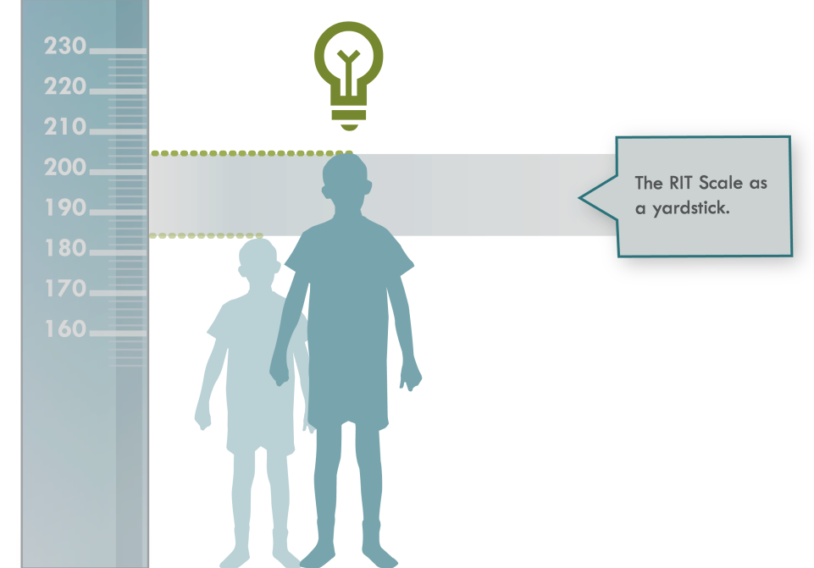
RIT (Rasch Unit) Scale
The RIT scale is one of most widely used achievement scales. (8+ million U.S. and over 400,00 international students take MAP)
Item Difficulty (RIT)
Equal interval achievement scale
Specifically designed to measure longitudinal growth
Grade and standards independent
Virtually no shift in NWEA RIT scale for more than two decades
Notes:
RIT (Rasch Unit) Scale
MAP assessments developed by NWEA use a scale called RIT to measure student achievement and growth in mathematics and reading from year to year.
RIT stands for Rasch unIT and is a measurement scale developed to simplify the interpretation of test scores. The RIT scale uses individual item difficulty values (RIT value) to determine the performance of individual students.
A RIT score is an estimation of a student’s instructional level and also measures student progress or growth in school.
The RIT scale is an equal-interval scale, much like feet and inches on a yardstick, and it is an efficient tool to improve student learning because it enables educators to pinpoint what students have learned and what students are ready to learn.
**
RIT (Rasch Unit) Scale is:
Achievement scale
Equal interval
Shows growth over time
Grade/Age and standards independent
Linked to The Learning Continuum
Learning Continuum = The Learning Continuum translates assessment scores into skills and concepts students may be ready to learn. It orders specific reading and mathematics skills and concepts by achievement level. The skills and concepts align to the goal structures and content of a state’s standards. For easy reference, the skills and concepts are grouped along the continuum according to the RIT measurement scale.

Slide 12
Normative Data (Mathematics): Bringing Context to the Data
Notes:
Measures of Academic Progress (MAP) – 2015 Normative Data
The 2015 NWEA RIT Scale Norms Study provides status and growth norms for individual students as well as for schools on each of the four RIT scales: Reading, Language Usage, Mathematics, and General Science. The study’s results are based on K – 11 grade level samples. Each sample is comprised of 72,000 to 153,000 student test records from approximately 1000 schools. These numbers vary by subject. These samples were drawn randomly from test record pools of up to 10.2 million students attending more than 23,500 public schools spread across 6,000 districts in 49 states. Rigorous procedures were used to ensure that the norms were representative of the U.S. school-age population.

Slide 13
Normative Data (Reading): Bringing Context to the Data
Notes:
Measures of Academic Progress (MAP) – 2015 Normative Data
The 2015 NWEA RIT Scale Norms Study provides status and growth norms for individual students as well as for schools on each of the four RIT scales: Reading, Language Usage, Mathematics, and General Science. The study’s results are based on K – 11 grade level samples. Each sample is comprised of 72,000 to 153,000 student test records from approximately 1000 schools. These numbers vary by subject. These samples were drawn randomly from test record pools of up to 10.2 million students attending more than 23,500 public schools spread across 6,000 districts in 49 states. Rigorous procedures were used to ensure that the norms were representative of the U.S. school-age population.

Slide 14
NWEA 2015 MAP Norms

Slide 15
NWEA MAP College and University Explorer

Slide 16
Other key terms to help us understand our own Teacher/Class Reports . . .
Mean: The arithmetic average of a group of scores
Median: The middle score in a list of scores
Normative mean: The mean for educators to compare class or grade-level performance of students in the same grade from a wide variety of nationwide schools
Standard deviation: A statistic expressing the homogeneity/heterogeneity of instructional level within a group of students.
Percentile rank: a normative statistic indicating how well a student performed compared to the students in the norm group
Learning Continuum: translates assessment scores into skills and concepts students may be ready to learn.
Notes:
Below are more detailed definitions of the key terms on this slide:
Mean = The arithmetic average of a group of scores. The mean is sensitive to extreme scores when population samples are small.
Median = The middle score in a list of scores; it is the point at which half the scores are above and half the scores are below.
Normative mean = is the mean for educators to compare class or grade-level performance of students in the same grade from a wide variety of nationwide schools.
Standard deviation = A statistic expressing the homogeneity/heterogeneity of instructional level within a group of students. The larger the standard deviation, the more academically diverse the group.
Percentile Rank = This number indicates the percentage of students in the NWEA norm group for this grade that this student’s score equaled or exceeded. The percentile rank is a normative statistic indicating how well a student performed compared to the students in the norm group. A student’s percentile rank indicates that the student scored as well as, or better than, the percent of students in the norm group. In other words, a student with a percentile rank of 72 scored as well as or better than 72 percent of the students in the norm group.
Learning Continuum = The Learning Continuum translates assessment scores into skills and concepts students may be ready to learn. It orders specific reading and mathematics (also language usage and science) skills and concepts by achievement level. The skills and concepts align to the goal structures and content of a state’s standards. For easy reference, the skills and concepts are grouped along the continuum according to the RIT measurement scale.

Slide 17
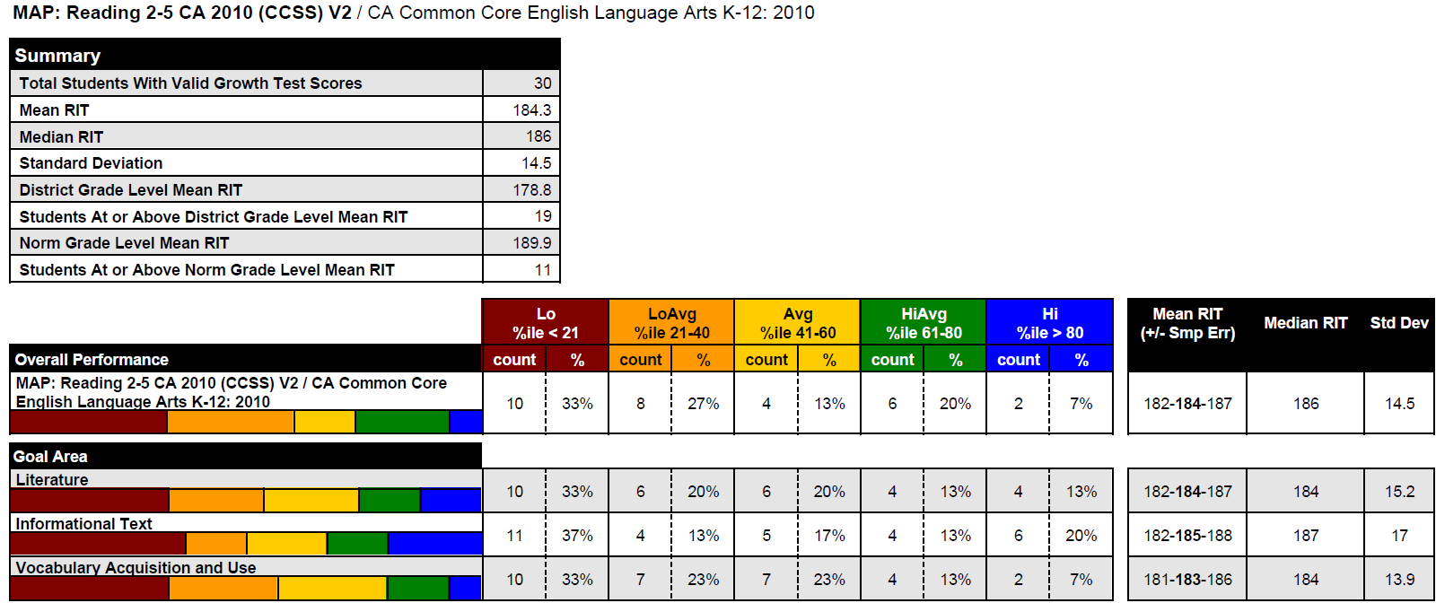
The Teacher/Class Report
Notes:
In this next section of the presentation, participants will have the opportunity to “roll up their sleeves” and work with the Teacher/Class Report. The Teacher/Class Report is one of the first reports that teachers can use after their students complete testing. The Teacher/Class Report provides overall class performance as well as individual student information.

Slide 18
Scavenger Hunt
Work with a partner to find the following:
Where is the Class Mean RIT?
Locate the Class Median RIT?
Standard Deviation?
Norm Grade Level Mean RIT?
How many and what percent of students had an overall “Average” performance?
Find the Goal Areas or Goal “Strands.” What areas do you see? Which Goal Area had the highest and lowest Mean RIT score?
Which had the highest and lowest Standard Deviation?
Notes:
The Teacher/Class Report contains the following:
Teacher’s name, class period and subject (this is listed at the top of the report)
The term, district, school and grouping information are also displayed (Please note that all identifying information was deleted from this screenshot)
The type of the test and version are included. This sample shows that this is a reading survey with goals test for grades 2-5 aligned to the Common Core 2010 standards
******
The table at the top of the screen summarizes data for 30 students. It contains the Total Students With Valid Growth Test Scores, class Mean RIT (184.3), the District’s Grade Level Mean RIT (178.8) and NWEA’s Norm Grade Level Mean RIT (189.9 for 3rd graders at the beginning of the school year). The Standard Deviation and the Median RIT for this class was 14.5 and 186, respectively.
******
The colorful graphic at the bottom of the slide includes a horizontal bar graph that represents this class’ overall performance on the reading assessment as well as their performance in each goal area. Each color of the bar graph represents a percentile range (or quintile). This yellow section of the horizontal bar graph, for example, represents the number of students in the goal area of literature who scored between the 41st and 60th percentile.
The rest of the table next to the bar graphs shows the number and percentage of students at each quintile, both overall in this subject area and in each specific goal performance area. The three columns to the far right show the Mean RIT scores, Median RIT scores and standard deviations for each goal performance area. The Smp Err or Sampling Error gives us some indication about the heterogeneity within the sample students. In other words, are all the students fairly close to the same achievement level or does the group show a lot of variability? The larger the sampling error of the mean, the greater the variability within the class.*
Source: NWEA Knowledge Academy training video – transcription from “Key Reports and Instructional Resources For Web-Based MAP® Users, Created 8/2012”
*Source: Response from Nate Jensen, Research Scientist, Northwest Evaluation Association, 1/16/2015

Slide 19
Let’s check our answers . . .
Work with a partner to find the following:
Where is the Class Mean RIT?
Locate the Class Median RIT?
Standard Deviation?
Norm Grade Level Mean RIT?
How many and what percent of students had an overall “Average” performance?
Find the Goal Areas or Goal “Strands.” What areas do you see? Which Goal Area had the highest and lowest Mean RIT score?
Which had the highest and lowest Standard Deviation?
1
2
3
5
6
7
4
Notes:
The Teacher/Class Report contains the following:
Teacher’s name, class period and subject (this is listed at the top of the report)
The term, district, school and grouping information are also displayed (Please note that all identifying information was deleted from this screenshot)
The type of the test and version are included. This sample shows that this is a reading survey with goals test for grades 2-5 aligned to the Common Core 2010 standards
******
The table at the top of the screen summarizes data for 30 students. It contains the Total Students With Valid Growth Test Scores, class Mean RIT (184.3), the District’s Grade Level Mean RIT (178.8) and NWEA’s Norm Grade Level Mean RIT (189.9 for 3rd graders at the beginning of the school year). The Standard Deviation and the Median RIT for this class was 14.5 and 186, respectively.
******
The colorful graphic at the bottom of the slide includes a horizontal bar graph that represents this class’ overall performance on the reading assessment as well as their performance in each goal area. Each color of the bar graph represents a percentile range (or quintile). This yellow section of the horizontal bar graph, for example, represents the number of students in the goal area of literature who scored between the 41st and 60th percentile.
The rest of the table next to the bar graphs shows the number and percentage of students at each quintile, both overall in this subject area and in each specific goal performance area. The three columns to the far right show the Mean RIT scores, Median RIT scores and standard deviations for each goal performance area. The Smp Err or Sampling Error gives us some indication about the heterogeneity within the sample students. In other words, are all the students fairly close to the same achievement level or does the group show a lot of variability? The larger the sampling error of the mean, the greater the variability within the class.*
Source: NWEA Knowledge Academy training video – transcription from “Key Reports and Instructional Resources For Web-Based MAP® Users, Created 8/2012”
*Source: Response from Nate Jensen, Research Scientist, Northwest Evaluation Association, 1/16/2015

Slide 20
Step 2: Let’s Roll Up Our Sleeves Interpreting One Teacher’s Class Report
Link up with a friend or two, what would this report suggest to our fellow teacher? What would you
share with her/him?
What’s the Class Mean?
What’s the Class Median?
What’s the Norm Grade Level Mean RIT?
Is the mean or median for this class above or below the Norm Grade Level Mean?
Which goal area has the highest standard deviation?
How could this information help her/him in designing classroom instruction?
In room environment?
In lesson planning?
In grouping and working with students?
Notes:
You may want to demo this first using the screenshot here. Ask participants to review their own data and then share out what they see with a partner. You may want to participants to share out their responses to #4 and #5
Modification: This activity could be skipped for this training and completed during a grade level or department meeting.

Slide 21
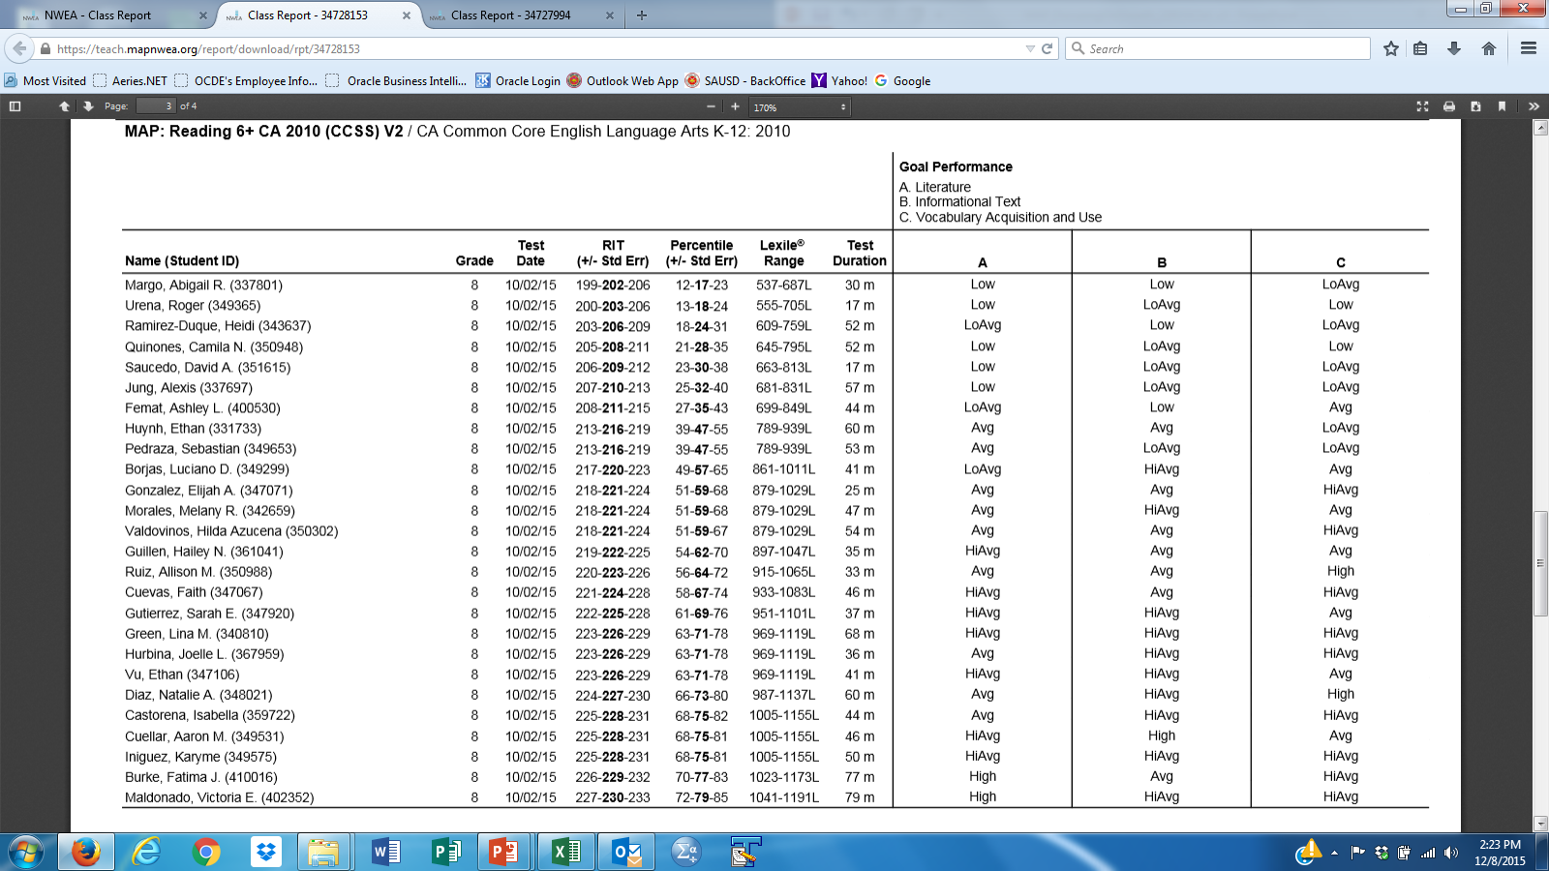
Class Report - MAP: Reading 6+ CA 2010
Grade 8
1
2
3
4
5
6
7
8
9
Pick a student, take a look at their RIT score . . .
What do you understand about that student based on their performance?
What instructional priorities might you set given their goal performance?
10
11
12
13
14
15
16
17
18
19
20
21
22
23
24
25
26
27
28
29
30
31
32
33
34
35
36
37

Slide 22
The ASG: Achievement Status and Growth Projection Report – A Great Report for Growth

Slide 23
Achievement Status and Growth Projection Report
Use the Sample Projection Report and the Normative Data document to answer the following questions
 | Name | First Term RIT Score | Projected Growth | Second Term Score
Student with the highest RIT score
Student with the lowest RIT score
How do the scores for these students compare to the mean RIT score for their grade level?
What do you notice about the projected growth for the highest and lowest students?
What conversations would you have with these two students related to goal setting? How might you involve the student in the goal-setting and monitoring process?

Slide 24
Achievement Status and Growth Report – Fall to Spring Let’s Take A Deeper Look
How do you know if a student made their growth targets?
Find a student who made their projected growth. What can you say about his/her growth?
Find a student who did not make their projected growth. What can you say about his/her growth?
What percentage of students met or exceeded their projected RIT?
How many students met or exceeded their projected RIT?

Slide 25
Achievement Status and Growth Calculator
Before
After

Slide 26
How do I help my students increase their ability to read and do mathematics?

Slide 27
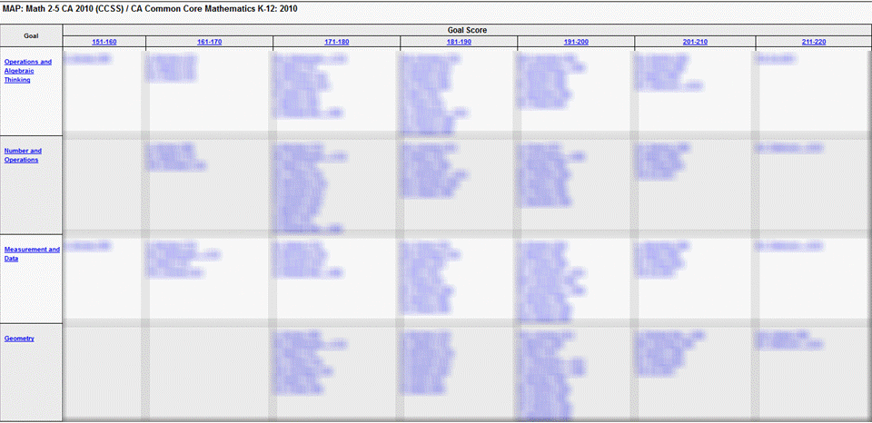
The Class Breakdown by Goal Report – A Demo and Recommended To-Do
Notes:
The Class Breakdown by Goal Report groups students by RIT score in blocks of 10 RIT points for each Goal Performance area in a particular subject. This report groups students with lower scores on the left and those students with higher scores on the right. This report is a good way to see clusters of student with similar scores within a class; this could be very helpful when creating flexible groups or differentiating lessons. This report can also identify outliers, those students who score noticeably higher or lower than their peers. In addition, the Class Breakdown by Goal Report identifies Goal Areas of strength and concern for a particular class.
It is important to note that the Class Breakdown by Goal Report links to The Learning Continuum making a connection between students’ scores and the skills they are ready to learn. How is this done? Teachers can click on any of the Goal areas running down the left side of the report.
Source: NWEA Knowledge Academy training video – transcription from “Key Reports and Instructional Resources For Web-Based MAP® Users, Created 8/2012”

Slide 28
The Learning Continuum – Connecting Data to Instruction

Slide 29
Learning Continuum (Activity) Highlighting
Using a highlighter,
Select a couple of standards
Highlight the similar skills as you move left to right across the continuum
What do you notice?
What implications might this have for planning and instruction?

Slide 30
Video link
https://www.youtube.com/watch?v=LGYa6ZacUTM Carol Tomlinson

Slide 31
Student Level Reports
Student Progress Report
and
Student Goal Setting Worksheets
Notes:
In this next section of the presentation, participants will have the opportunity to “roll up their sleeves” and work with the Teacher/Class Report. The Teacher/Class Report is one of the first reports that teachers can use after their students complete testing. The Teacher/Class Report provides overall class performance as well as individual student information.

Slide 32
Student Video
Here is the link to the MAP Testing Video that I had six of my 8th grade ELA students make yesterday after school. The video is already posted on our YouTube channel under the news playlist, and the tutorial playlist.
MAP TESTING STUDENT VIDEO
https://www.youtube.com/watch?v=Ew9a9tX7kn8&list=PLN3ZhyX39j8WdB3IsVinMwAXSogIILfNE&index=1
Deborah Park Language Arts Mendez Fundamental Intermediate School Santa Ana Unified School District

Slide 33
Student Progress Report

Slide 34
Student Goal Setting Worksheets

Slide 35
Resources for individualizing instruction
Learn Zillion – Lesson Library
Khan Academy - Math Videos
RITtoResource.org –
Teach Your Monster To Read
FCRR.org (Florida Center for Reading Research)
NWEA Interactive MAP games
IXL

Slide 36
Contact Information
Research and Evaluation
Santa Ana Unified School District
(714) 558-5850
Tran Keys, Ph.D., Executive Director
Emily Wolk, Ph.D., Assistant Director

